Slide 1
GIS-Based Predictive Habitat Model
Kentucky Transportation Center
www.ktc.uky.edu
Expert-systems modeling for threatened and endangered species
Benjamin Blandford, PhD
University of Kentucky
Kentucky Transportation Center
Benjamin.Blandford@uky.edu
Michael Shouse, PhD
University of Southern Illinois – Edwardsville
Department of Geography
mshouse@siue.edu

Slide 2
Overview
Kentucky Transportation Center
www.ktc.uky.edu
Research Background
Aquatic species considered:
  Kentucky arrow darter
Methods
Model Results
Discussion
Other species considered (time permitting)
  Blackside dace

Slide 3
Research Background
Kentucky Transportation Center
www.ktc.uky.edu
NEPA
Threatened and Endangered Species Act
KYTC must conduct species sampling in areas of potential T&E habitat
Model designed to be a tool for biologists to use when assessing a stream

Slide 4
Research Background
Kentucky Transportation Center
www.ktc.uky.edu
Methodology adapted and modified from a previous predictive archaeological model developed by KYTC/KTC.
Designed to harness the existing knowledge of experts in the subject area to create a spatially explicit model of likelihood
Not a “biologist in a box”

Slide 5
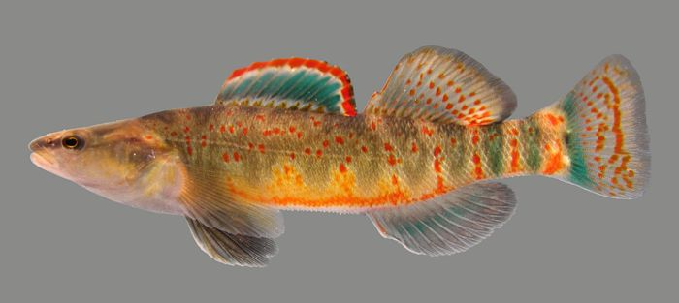
Kentucky Arrow Darter
Kentucky Transportation Center
www.ktc.uky.edu
Candidate for federal listing by USFWS
Has disappeared from significant portions of its historic range
Habitat degradation linked to human influences, including mining, logging, agriculture, and development.
Image: www.fws.gov

Slide 6
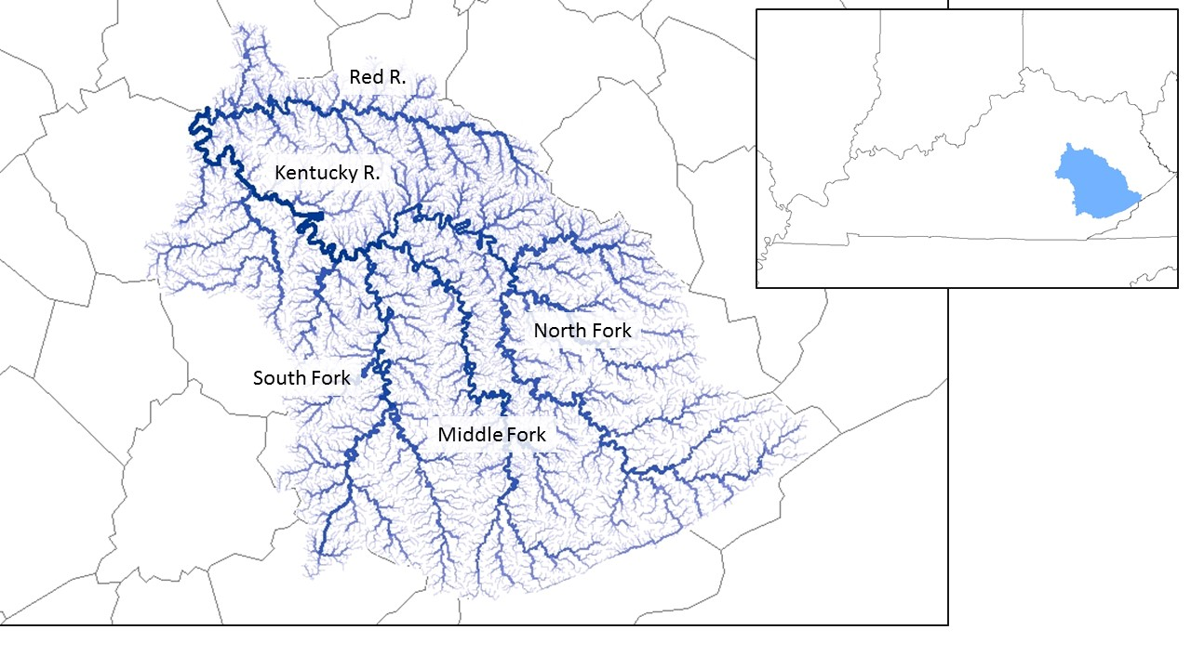
Kentucky Arrow Darter
Kentucky Transportation Center
www.ktc.uky.edu
Endemic to upper Kentucky R. system
  Upstream from confluence of Kentucky R. and Red R.
Appx. 13,600 km of streams

Slide 7
Methods
1.
Variable Selection
Kentucky Transportation Center
www.ktc.uky.edu
2.
GIS Data Gathering
A GIS-Based, Expert-Driven, Weighted Model
3.
Variable Parameterization
4.
GIS Data Processing
Expert Input
5.
Weighted Model Development
6.
Model Testing Against Presence Data
7.
Model Evaluation

Slide 8
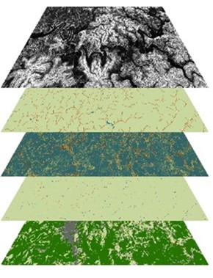
Methods
Kentucky Transportation Center
www.ktc.uky.edu
Expert Input
1.
Variable Selection
Stream gradient
Canopy cover
Land cover
Riparian area
Stream order

Slide 9
Methods
Kentucky Transportation Center
www.ktc.uky.edu
2.
GIS Data Gathering
Data Source | Description | Variable(s) Derived
Digital Elevation Model | 10 m resolution digital elevation model from USGS | Stream Gradient
Geologic Structures 24k | This data set is derived from the 7.5-minute geologic quadrangle maps (scale 1:24,000) | Riparian (Alluvium) Width
National Hydrologic Dataset | Stream network for the Kentucky River Basin (1:24000) | All Variables
Gap Analysis | Land cover data from the Southeast Gap Analysis Project | Land Cover
LANDFIRE | Existing Vegetation Cover as percent cover of the live canopy layer for a 30-m grid cell. | Forest Canopy

Slide 10
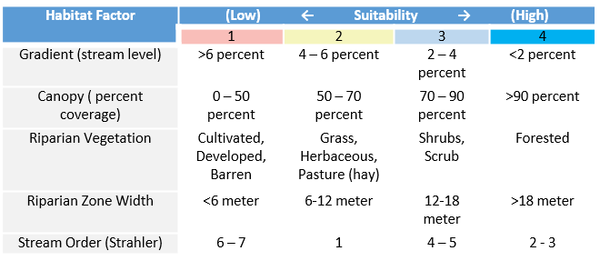
Methods
Kentucky Transportation Center
www.ktc.uky.edu
Expert Input
3.
Variable Parameterization

Slide 11
Methods
Kentucky Transportation Center
www.ktc.uky.edu
4.
GIS Data Processing
Model created using ArcGIS 10.1 and ET GeoWizards
Streams in model divided into appx. 100 m segments derived from the USGS National Hydrologic Dataset 24k
Resulted in 132,783 segments
These segments are the basic unit of analysis for each variable created

Slide 12
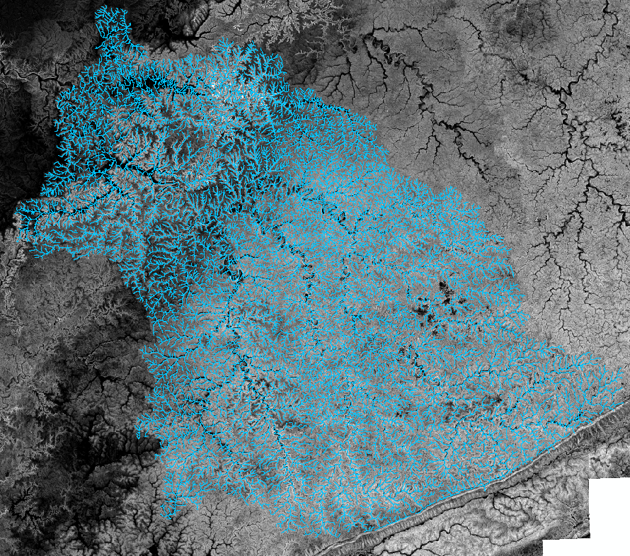
Methods
Kentucky Transportation Center
www.ktc.uky.edu
4.
GIS Data Processing
Stream Gradient
Calculated as the elevational difference between each 100 m segment divided by the length of the segment.
Endpoint elevation derived by finding the minimum cell value using an 8-neighbor classification around each endpoint location.

Slide 13
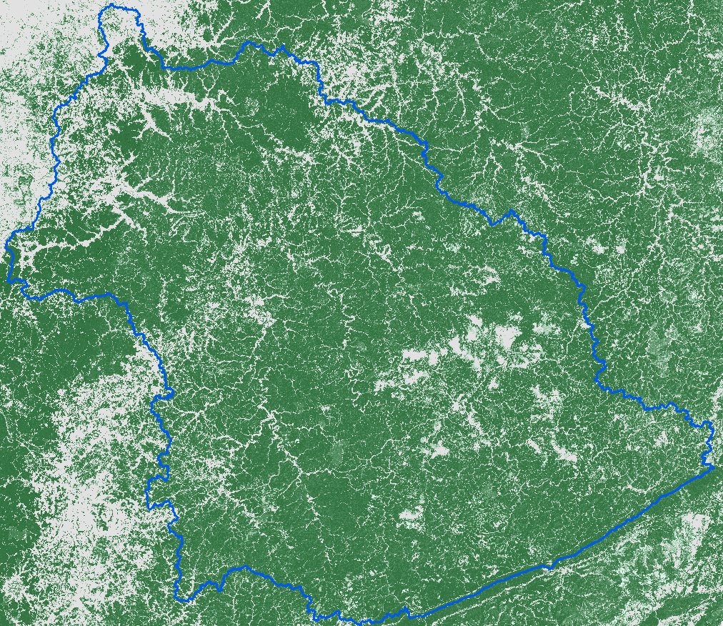
Methods
Kentucky Transportation Center
www.ktc.uky.edu
4.
GIS Data Processing
Canopy
LANDFIRE data describe the portion of the forest floor covered by the vertical projection of tree crowns.
Data derived from Landsat imagery and spatially explicit biophysical gradients to generate a percent canopy cover at 30 m resolution.

Slide 14
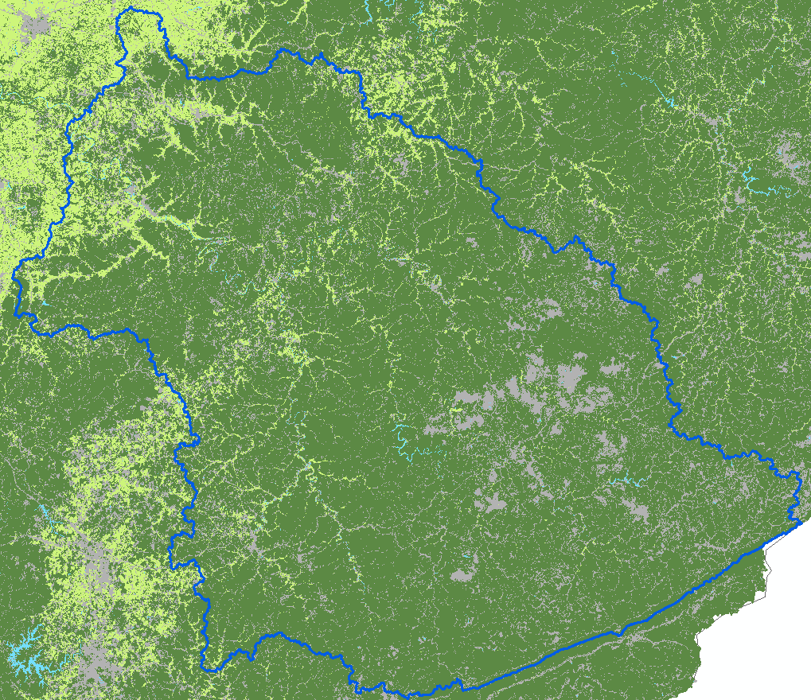
Methods
Kentucky Transportation Center
www.ktc.uky.edu
4.
GIS Data Processing
Land Cover
Land cover data extracted from the Southeast Gap Analysis Project.
Land cover data for the Kentucky River basin at a resolution of 30 m.

Slide 15
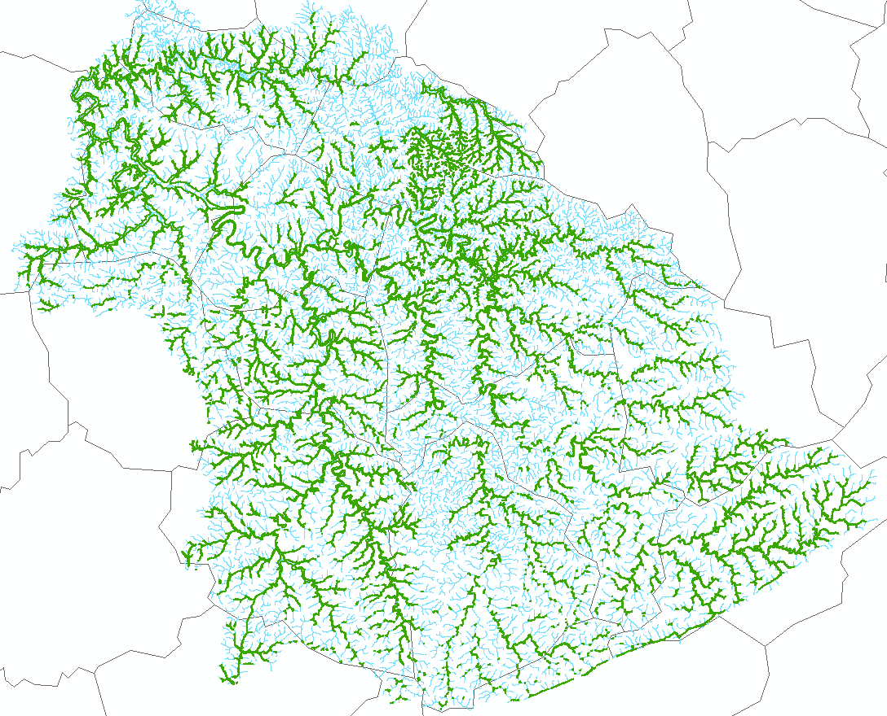
Methods
Kentucky Transportation Center
www.ktc.uky.edu
4.
GIS Data Processing
Riparian Area
Two components of riparian area already covered by other habitat factors: canopy and land cover.
This variable considers the extent of alluvium associated with the stream network.
Average alluvium width calculated for each 100 m stream segment.

Slide 16
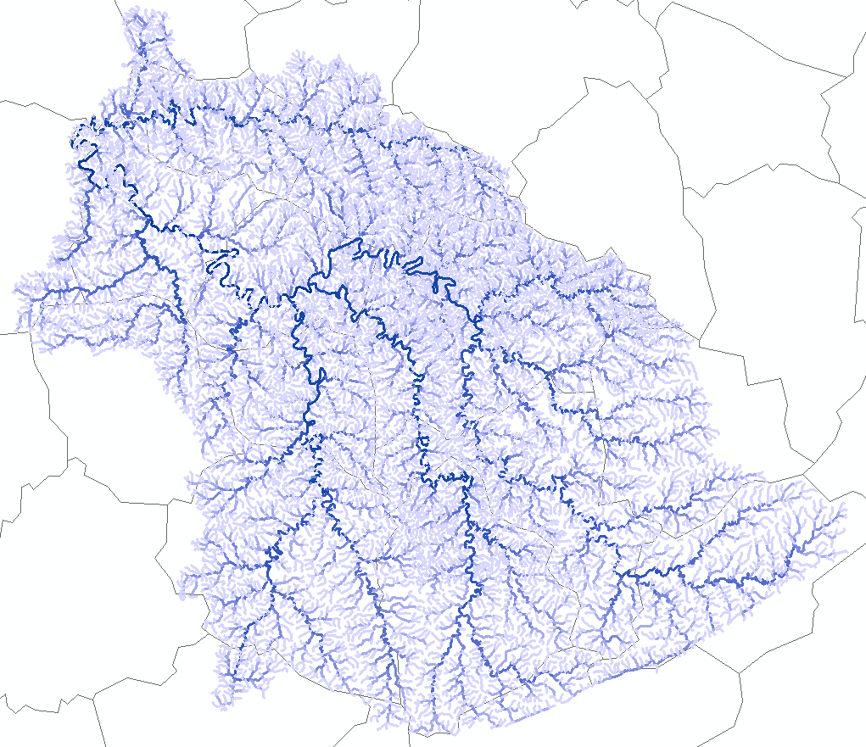
Methods
Kentucky Transportation Center
www.ktc.uky.edu
4.
GIS Data Processing
Stream Order
Streams in this basin range from an order of 1 (feeder streams) to 7 (Kentucky River).
Python script developed to calculate the stream order associated with each stream segment.

Slide 17
Methods
Kentucky Transportation Center
www.ktc.uky.edu
Expert Input
5.
Weighted Model Development
Gradient: 30 percent
Canopy: 20 percent
Land cover: 10 percent
Riparian width: 10 percent
Stream Order: 30 percent
Two overarching rules for model
All stream segments receive an overall habitat suitability score of 1-4:
  1) Very unsuitable
  2) Unsuitable
  3) Suitable
  4) Very Suitable

Slide 18
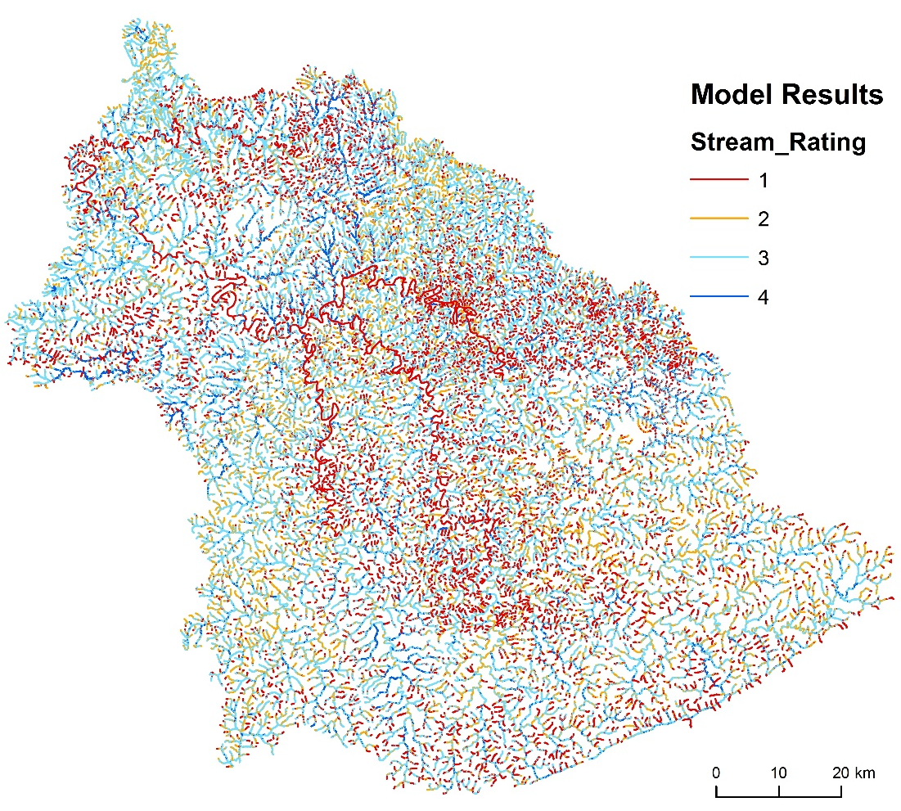
Methods
Kentucky Transportation Center
www.ktc.uky.edu
6.
Model Testing Against Presence Data
Obtained Kentucky arrow darter presence data from USFWS.
Includes 75 arrow darter occurrences in the upper Kentucky River watershed.
Precision and accuracy of model tested using locational modeling statistics

Slide 19
Model Results
Kentucky Transportation Center
www.ktc.uky.edu
7.
Model Evaluation
p(M): base rate of the model indicating an occurrence
  39.06% streams are less suitable
  60.94% streams are more suitable
p(S): base rate that an arrow darter occurrence will be found at some location
  Calculated as the total number of occurrences divided by the total number of stream segments (75/132,782 = 0.056%)
p(M/S): common calculation for model accuracy
  97.33% of arrow darter occurrences found in stream segments modeled favorably
  2.67% in stream segments modeled unfavorably
    0% of these in highly unsuitable segments

Slide 20
Model Results
Kentucky Transportation Center
www.ktc.uky.edu
7.
Model Evaluation
p(S/M): Probability of an occurrence within each of the suitability categories (compare to column 2)
p(M/S)-p(M): Improvement over chance of correctly predicting arrow darter occurrences
  Negative % for unsuitable categories
  Positive % for suitable categories
    32.4% improvement for Category 4
p(S/M)/p(S/M’): Model improvement ratio; how many more times likely of an arrow darter occurrence for each category
  8.1 times more likely for highly suitable segments

Slide 21
Discussion
Kentucky Transportation Center
www.ktc.uky.edu
40% of the independent presence data were located in the top suitability category, which only contained 7.61 percent of stream segments.
When the model is divided into two categories of unsuitable (1-2) and suitable (3-4), appx. 60% of streams are identified as suitable.
97% of dace occurrences found here
60% of streams as suitable as overfit?
  Arrow darter is candidate for federal protection; need for range expansion
  Model results identify potential for suitable habitat as an avoidance measure for state transportation agencies

Slide 22
Discussion
Kentucky Transportation Center
www.ktc.uky.edu
Model results demonstrate this methodology’s ability to identify suitable habitat
  Simply intended to be a tool that maps an expert’s knowledge of the subject
GIS-based expert systems methodology is transferable:
  To other aquatic species
  Potential for terrestrial threatened and endangered species?
  Flora and fauna?
Methodology is transferable across disciplines:
  Originated as a predictive model for archaeologists

Slide 23
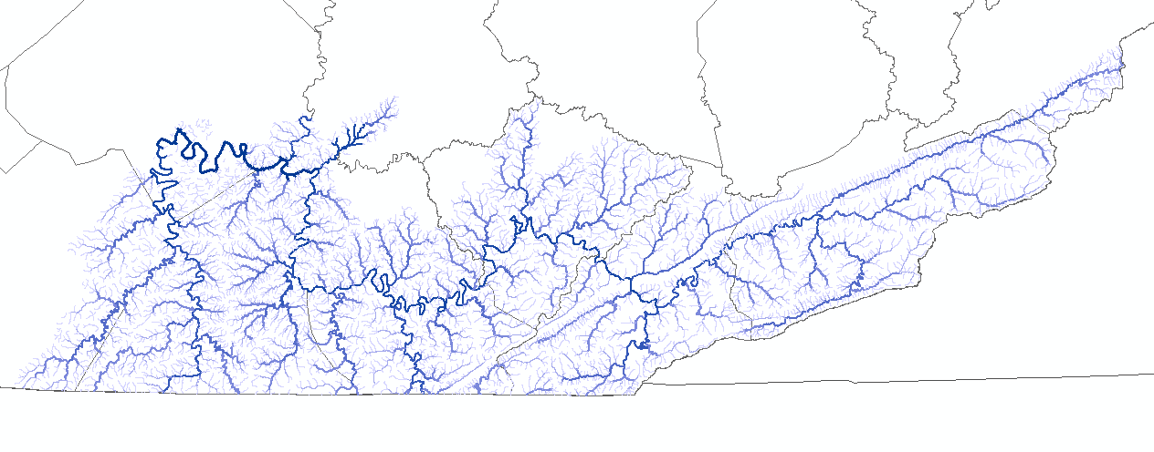
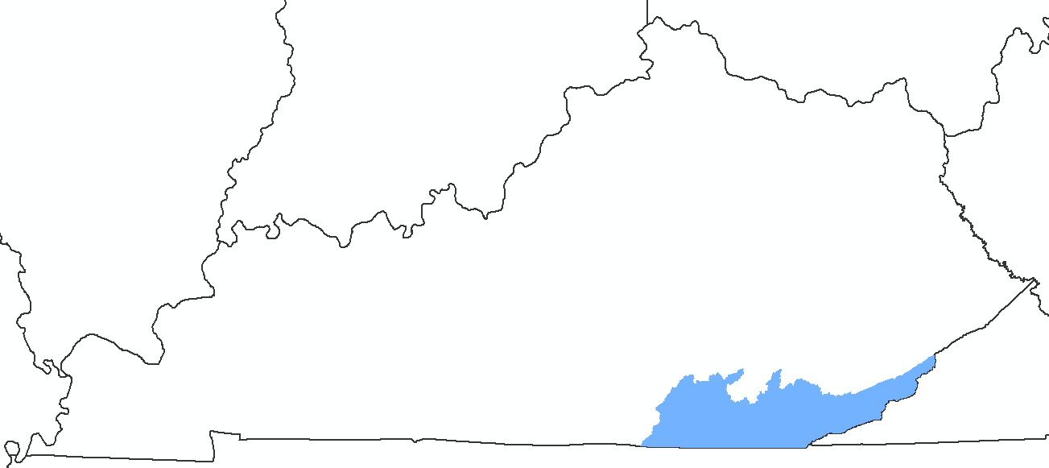
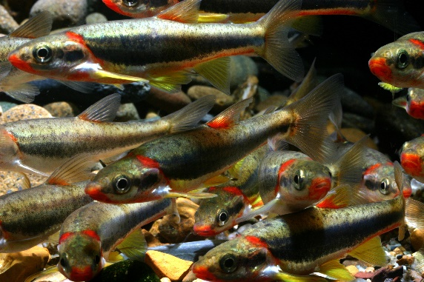
Blackside Dace
Kentucky Transportation Center
www.ktc.uky.edu
Laurel R.
Poor Fork
Clover Fork
Cumberland R.
Big South Fork
Clear Fork
Image: www.fws.gov

Slide 24
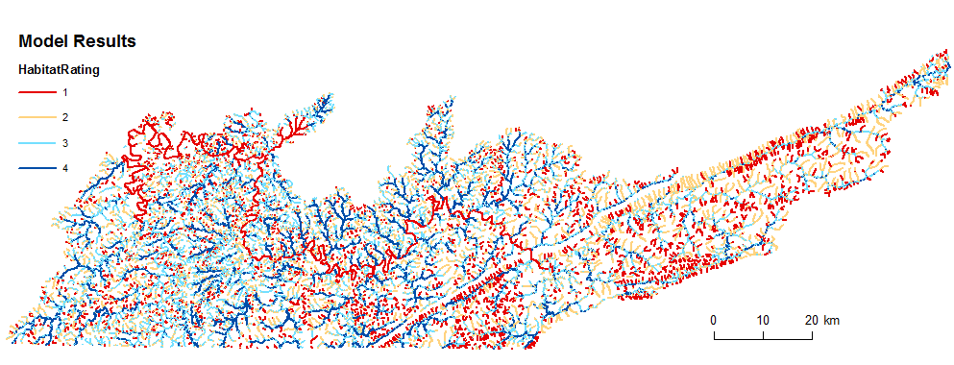
Blackside Dace
Kentucky Transportation Center
www.ktc.uky.edu

